Slide 1
Trauma – Grief & Loss
By Jane Oakley-Lohm
An interactive presentation at your own pace.

Slide 2


Training
Trauma Grief and Loss from a different perspective

Slide 3
Who is Jane Oakley- Lohm
Jane Oakley-Lohm is a retired clinical supervisor, trainer, counsellor and mediator. A retired Justice of the Peace for a large remote area of Australia and has experience in establishing and managing projects in Central Australia.
In this region there are many different cultures and 26 Aboriginal language groups. The vastness of this region can be envisaged when one considers that a map of this region placed over a map of Europe would cover many European countries.
Jane has lived and worked in Central Australia in Alice Springs and remote areas of Australia for 30 years and now resides in Tasmania.

Slide 4
Background
One project that I ran was on grief it was run through the Northern Territory Government and La Trobe University of Melbourne.
It looked at the different cultures and traditions of the region.
What was grief for these people?
How did they manage?
Did they still have the resources that they needed in the region and if not what did they require?
From this research I made 12 recommendations to the Northern Territory Government.

Slide 5
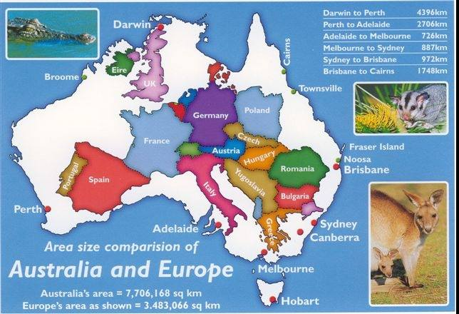
Compare Australia to Europe

Slide 6
Jane Oakley-Lohm’s
Theory of Trauma & Grief
I am going to take you on a journey of looking at grief from another prospective.
On this journey I will explain a theory of mine which I am happy to share with you.
To do this we are going to look at how western cultures deals with loss compared to other older cultures of the world deal with loss
Notes:
(After exercise)
Grief can be:
death of a family member or friend
loss of job or job opportunity
ill health
friends or family members shifting on ending a relationship
death of an animal
loss a role in life
financial loss
loss of something sentimental
loss of a way of life
loss of identity
loss of rights or freedom
loss of culture and language
having to give up something that is special to you
loss of a family role
loss of your home
loss of future plans
loss of the ability to provide for one’s self and others
loss of a dream
loss of direction
loss of someone to share your life and stories with
and so much more.

Slide 7
Explore grief
Lets first explore grief and what is a loss?
We all connect better with someone if we have a good understanding of what grief is?
  Think about the different cultures and religions of the world? How people are bought up differently, eg; access to a good educational background, good communication at home whilst growing up, access to world wide ideas and observing these with a free choice to have your own opinion.

Slide 8
Grief is many things.
  In western society, (openly) we mostly associate grief with death, when someone we know has died and we feel pain, but grief is also felt in many more situations that surround us every day.
Understanding what trauma & grief really is, allows us to be resilient and learn strategies for coping.

Slide 9
My knowledge and understanding of trauma, loss and how this effects different people with different beliefs and cultures was developed through my work with Indigenous peoples and others in Central Australia.
My knowledge is not based on one culture or one group of Aboriginal people as Aboriginal groups are different and this needs to be respected. Traditionally the Australian Aboriginal cultures varied from one region to another and in fact from community to community in the Central Australian Region.

Slide 10
What is grief
Grief is the natural reaction to a loss
Building a rapport with someone grieving will help them to share what they are going through
Often people don’t know how a situation is effecting them, they could feel confused, or perhaps they don’t understand any part of what they are feeling, they are just emotionally.
In the western world today more people do seek help
Before someone can access the right help in grief or support someone in grief they must understand a bit about what is grief ?

Slide 11
What is grief?
Grief is a response to anything that is taken away from us- where we feel we are not in control. Somewhere between 1-10
Grief is a response to a change that we don’t instigate and that we don’t like.
In western society people mostly like to be in control of what they do, therefore when they feel something has happened that is out of their control they often don’t like it.

Slide 12
Trauma & Grief can be:
death of a family member or friend
loss of job or job opportunity
ill health
friends or family members shifting on ending a relationship
death of an animal
loss a role in life
financial loss
loss of something sentimental
loss of a way of life
loss of identity
loss of rights or freedom
loss of culture and language
A traumatic experience where there has been fear, death, felt trapped, abused, torture, rape, witness to violence eg shooting
having to give up something that is special to you
loss of a family role
loss of tradition
loss of your home
loss of future plans
loss of the ability to provide for one’s self and others
loss of a dream
loss of direction
loss of someone to share your life and stories with
compounding losses
and so much more.

Slide 13
Trauma
There is information that states some severe trauma can be caused when:
Undergone in childhood
Repeated
Perpetrated by a caregiver
Human caused
Unpredictable

Slide 14
Trauma effects
Some people may show signs of:
depression
anxiety
post traumatic stress disorder
eating disorders
substance abuse and dependence
personality disorders
dissociative disorders

Slide 15
In this presentation we are going to be touching on:
Grief responses
Body responses
Normalise grief
Build rapport
Stages of grief (western culture)
Cultures work differently in grief etc

Slide 16
Normalise Grief
It is normal to feel: sad, angry, anxious, shocked, overwhelmed, regretful, relieved, guilt, isolated, irritable or numb in grief.
To help people through this process it is important to have friends and family support and a counsellor that can normalise these emotions to the person. Having one day good and one day bad is normal.

Slide 17
Individual Verses
Community Support
The key here is understanding people working as individual’s verses people working as a community.
Community is also known as family in some Aboriginal communities.
From the people that I have talked with, it appears that the harsher the living conditions in communities the closer people have to work together and rely on one another to survive.
They must work as a team and not as an individual.

Slide 18
The grief tree
The grief tree shows you how to deal day to day and then it goes into how to move forward again with who you are today as you are not the same person as you were before the grief.
First we need to devise a day to day strategy that will nurture us and at the same time assist us to regain some control back again.

Slide 19
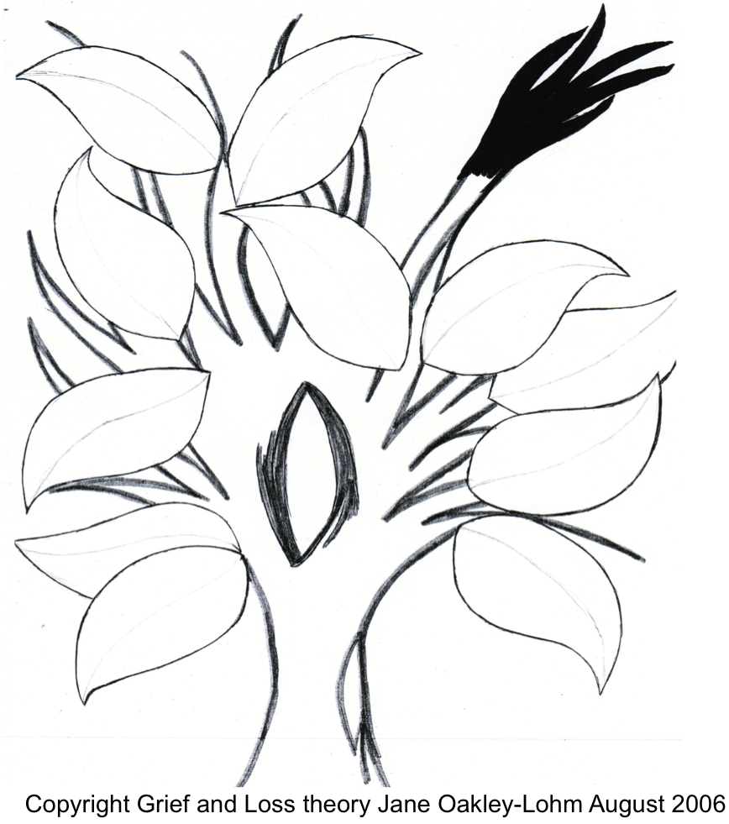
GRIEF TREE:

